Slide 1
Computer Network (MCA-103) UNIT - I

Slide 2
Overview
Learning Objective:
Understand basics, topologies and working mechanism of wired and wireless computer networks.
Analyze the features and operations of protocols of OSI reference model & TCP/IP protocol suite.
Design, calculate, and apply routing mechanisms for lPv4 & lPv6.
ldentify the networking requirements for an organization and select & propose appropriate architecture and technologies.
Work on Network addressing, design and implementation.

Slide 3
Overview
UNIT-1
Introductory Concepts:
Goals and Applications of Computer Networks,
OSI reference model,
TCP/lP protocol suite,
networks topology & design.
Networking Devices (Hub, Bridge, Switch & router).
Physical Layer
Communication Satellites
Digital Signal Encoding Formats, Digital to analog Modulation
Digitization - Sampling Theorem, PCM, DM, Analog to digital Modulation
The Mobile Telephone System
Multiplexing

Slide 4
Overview (cont..)
UNIT-2
The Data Link Layer
Data Link Layer introduction
Error Detection and Correction,
Flow Control and Error Control protocols
Medium access sub-layer
Channel allocation problem
ALOHA Protocols,
Carrier Sense Multiple Access Protocols,
CSMA with Collision Detection,
Collision free protocols,
Ethernet, wireless LANs, Blue Tooth, Wi-Fi

Slide 5
Overview (cont..)
UNIT-3
Network Layer
Functions of network layer
lPv4: Classful & classless addressing,
Routing algorithms, lP packet format
lPvS: addressing, neighbor discovery, address auto configuration
Mobile lP
Mobility in networks,
lP Multicasting (Source based tree & Group shared tree)

Slide 6
Overview (cont..)
UNIT-4
Transport Layer:
Transport layer functions
Transport layer protocols:UDP, TCP
Connection management, flow control, error control and congestion control.
Application Layer
DNS, Electronic Mail, www, firewalls
Concept of public & private keys.

Slide 7
Unit 1
In this Unit we will discuss :
Introduction and The Physical Layer: Uses of Computer Networks, Network Hardware,
Network Software, Reference Model (OSI, TCP/IP Overview), The Physical Layer,
Theoretical Basis for Data Communication, Guided Transmission Media, Wireless
Transmission, Communication Satellites,
Digital Signal Encoding Formats
Digital Modulation
Analog Modulation –The Public Switched Telephone Network, The Mobile Telephone System

Slide 8
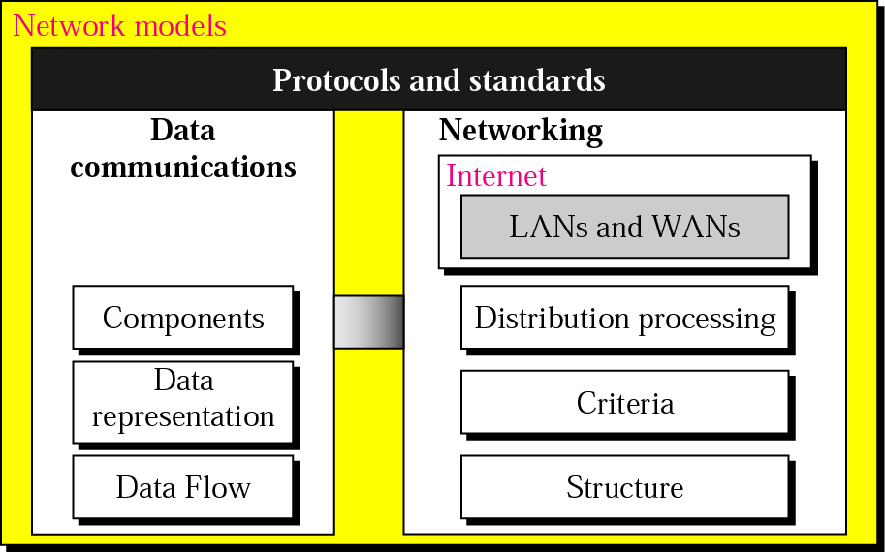
Introduction

Slide 9
Introduction
BASICS OF DATA COMMUNICATION
Components
Data Representation
Direction of Data Flow

Slide 10
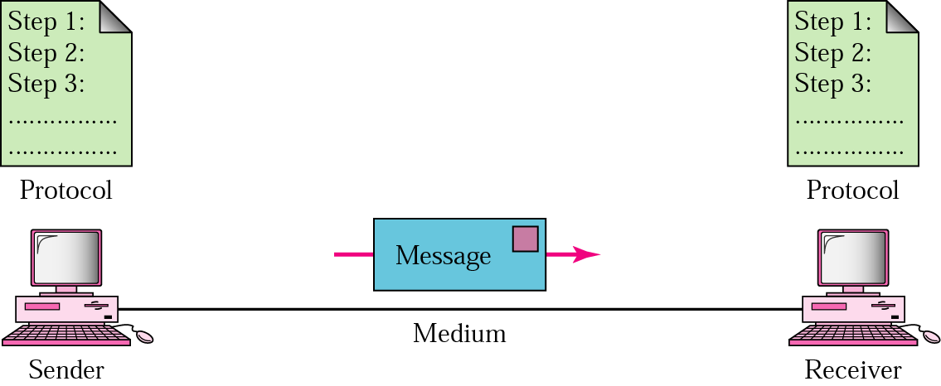
Introduction
Five components of data communication

Slide 11
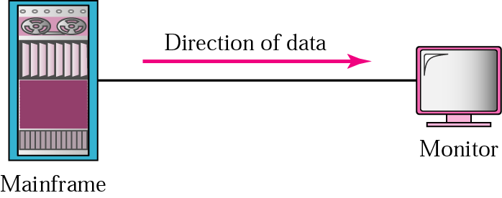
Data Flow
Simplex

Slide 12

Data Flow
Half-Duplex

Slide 13

Data Flow
Full-Duplex

Slide 14
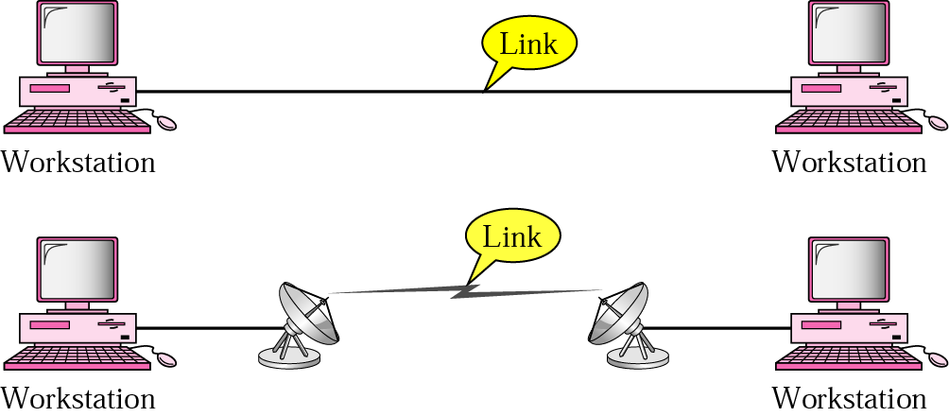
Types of Connection
Point-to-point connection

Slide 15
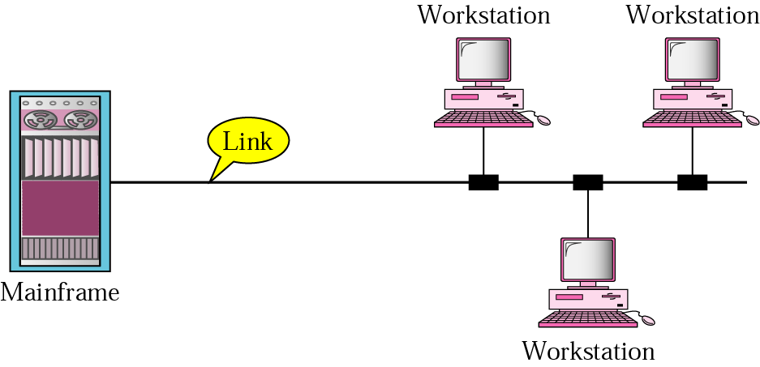
Types of Connection
Multi Point Connection

Slide 16
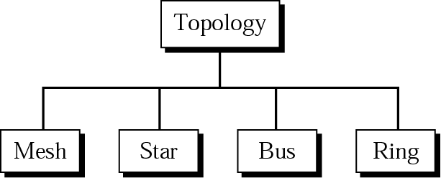
Introduction
Categories of Topology

Slide 17
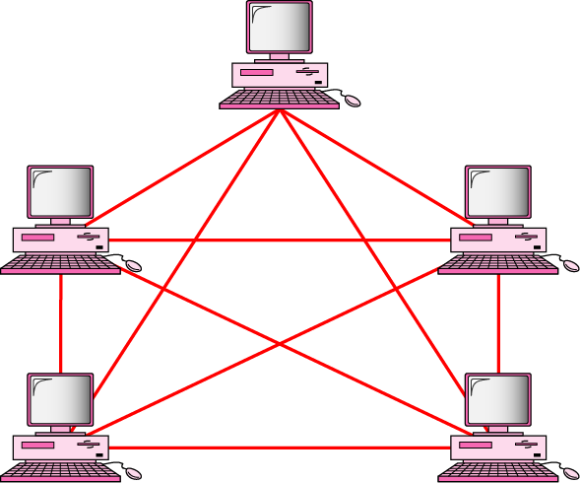
Introduction
MESH (FULLY CONNECTED)

Slide 18
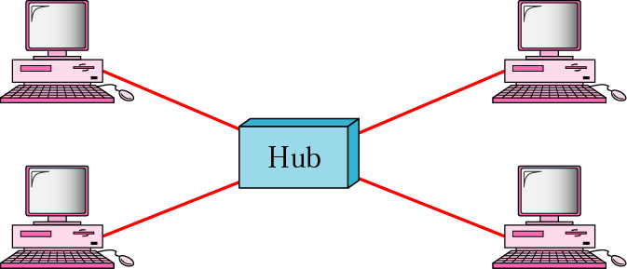
Introduction
STAR

Slide 19
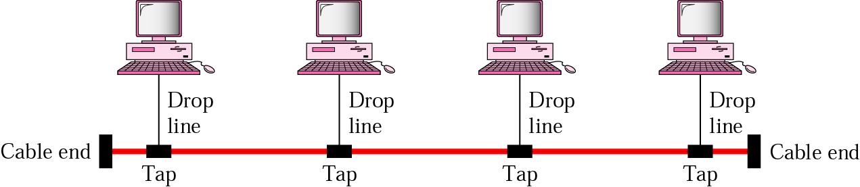
Introduction
BUS

Slide 20
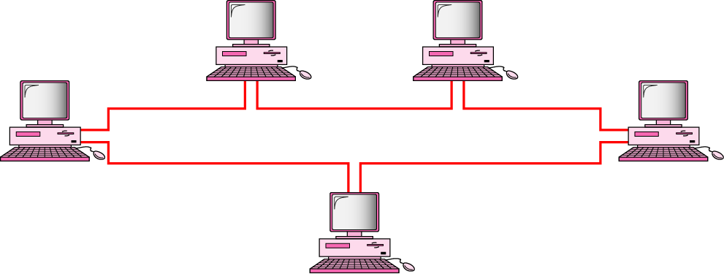
Introduction
RING

Slide 21
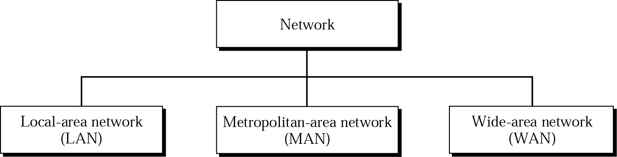
Introduction
Categories of Networks

Slide 22
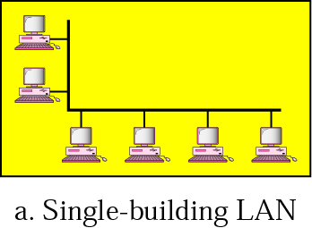
Introduction
LAN

Slide 23
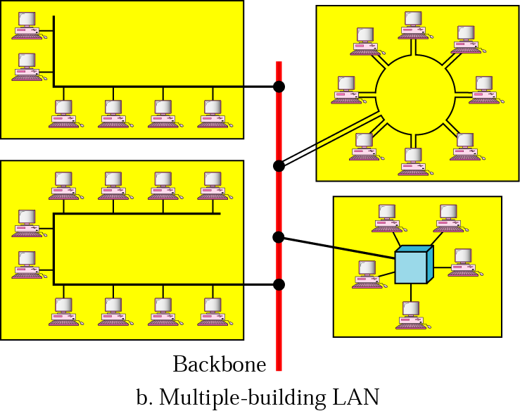
Introduction
LAN

Slide 24
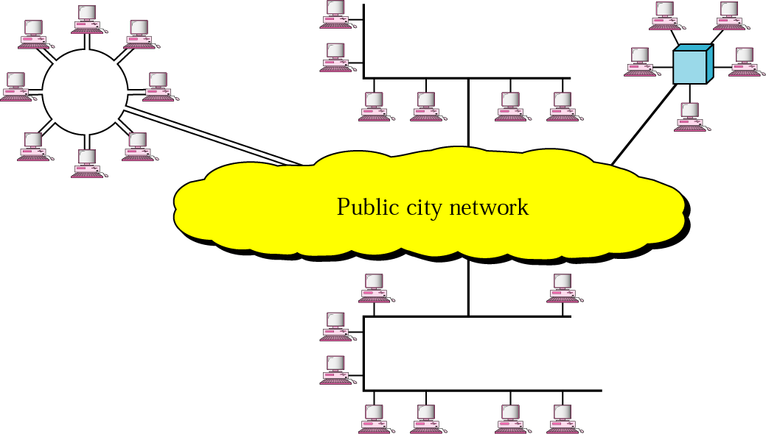
Introduction
MAN

Slide 25
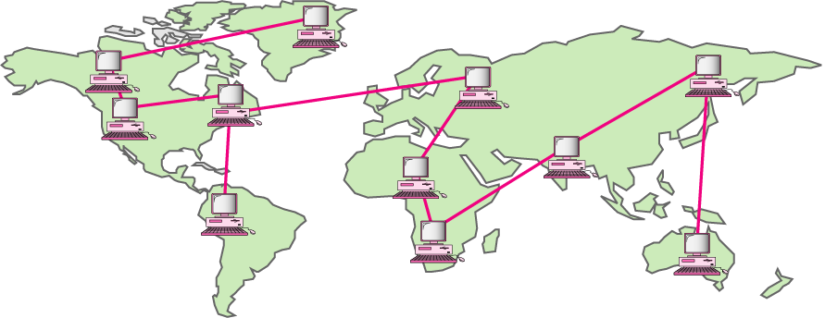
Introduction
WAN

Slide 26
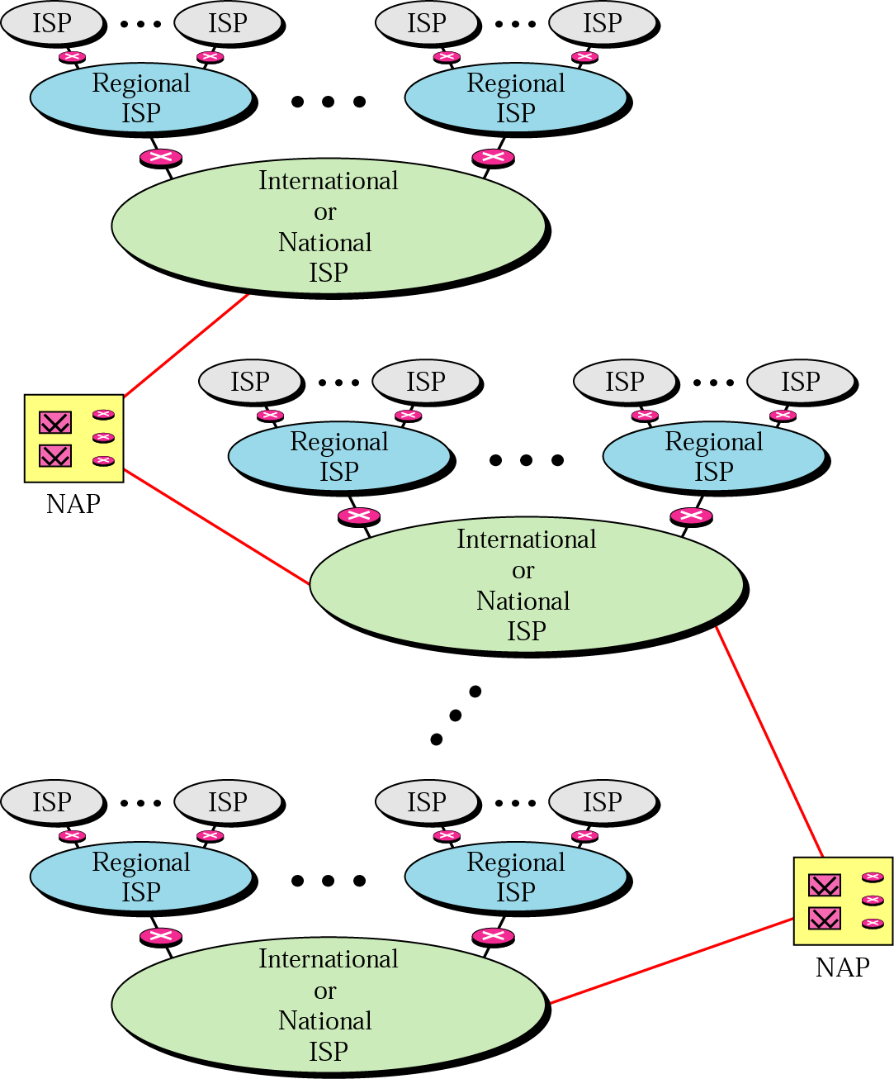
Internet Today

Slide 27
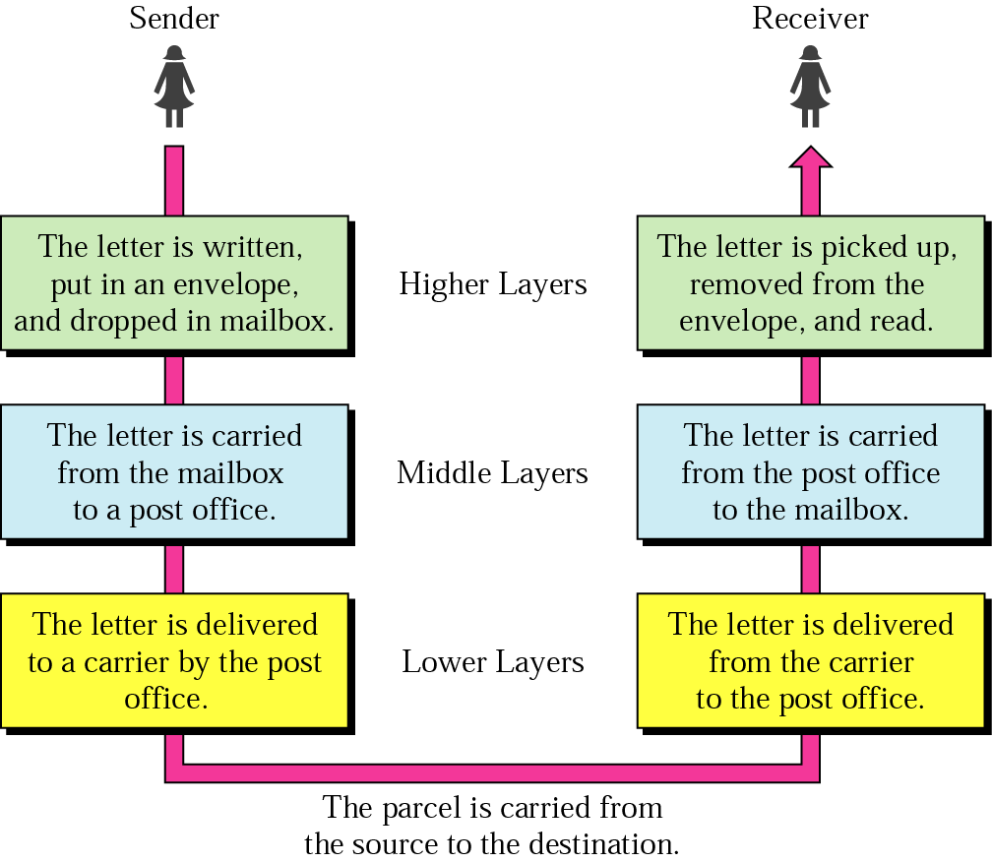
Network Models

Slide 28
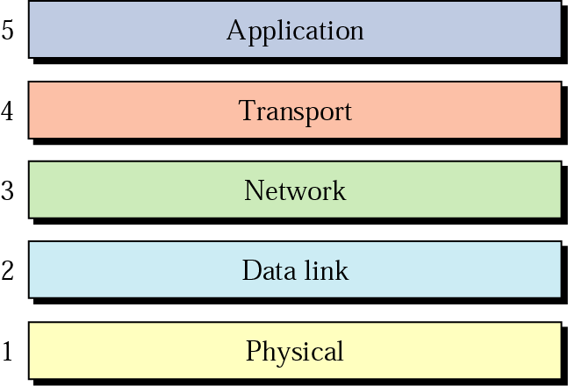
Internet Layers

Slide 29
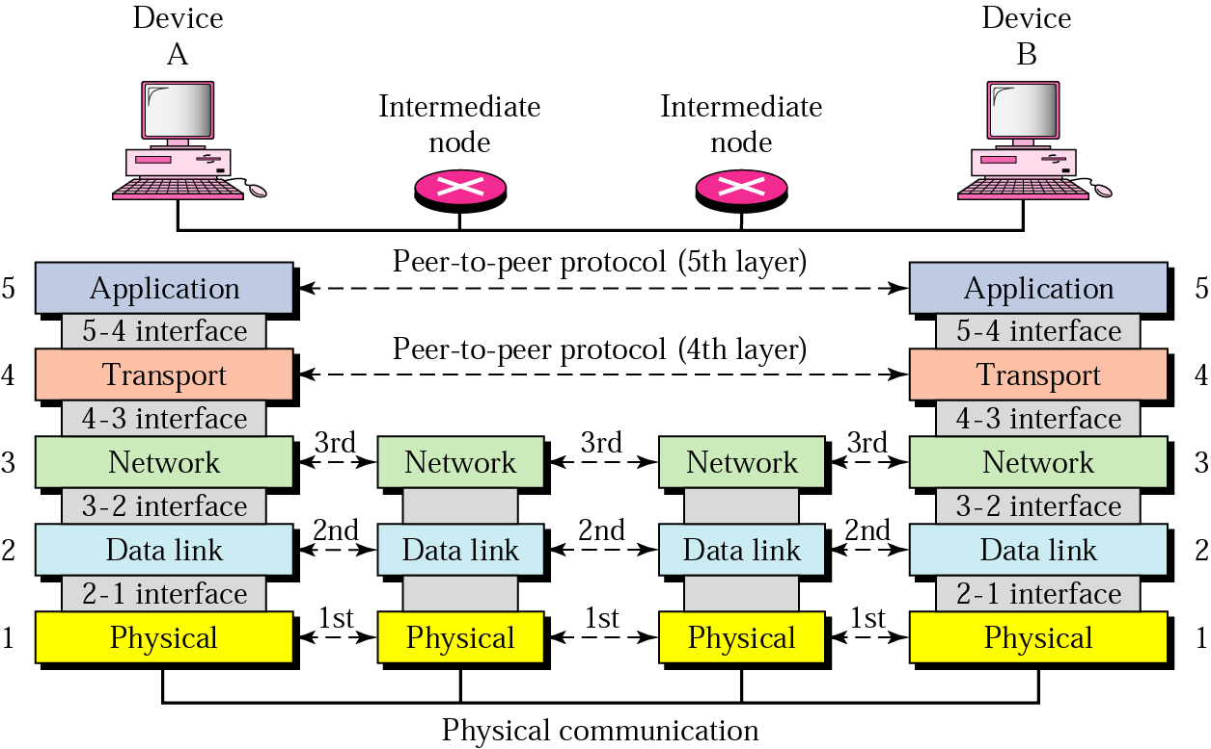
Internet Layers

Slide 30
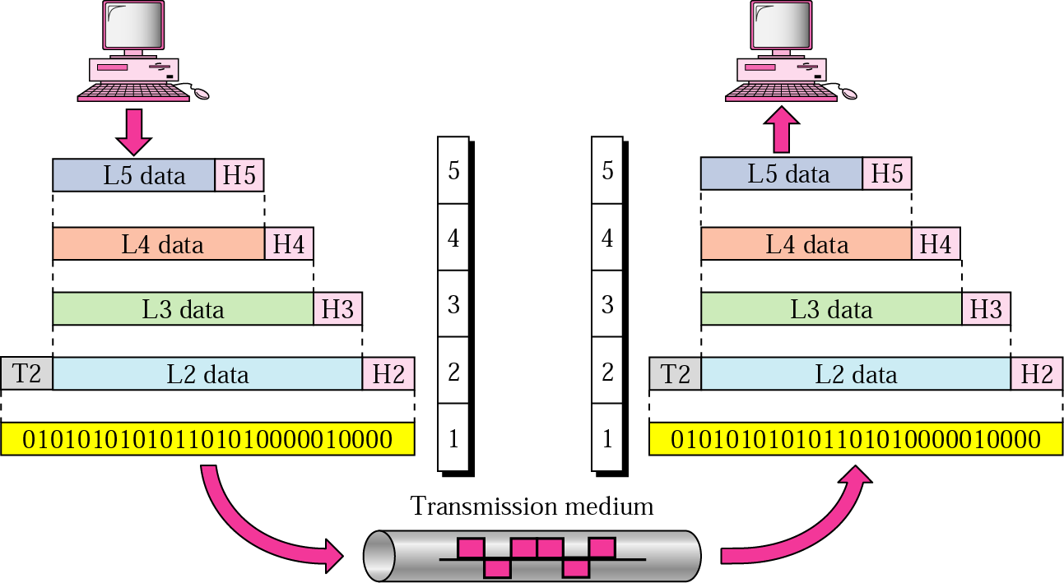
Internet Layers

Slide 31
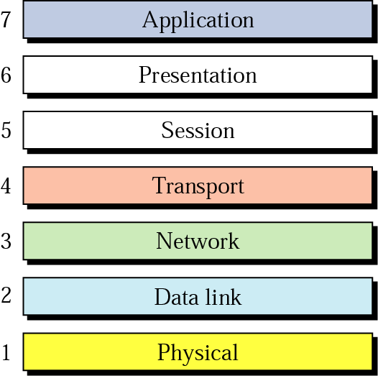
OSI Model

Slide 32
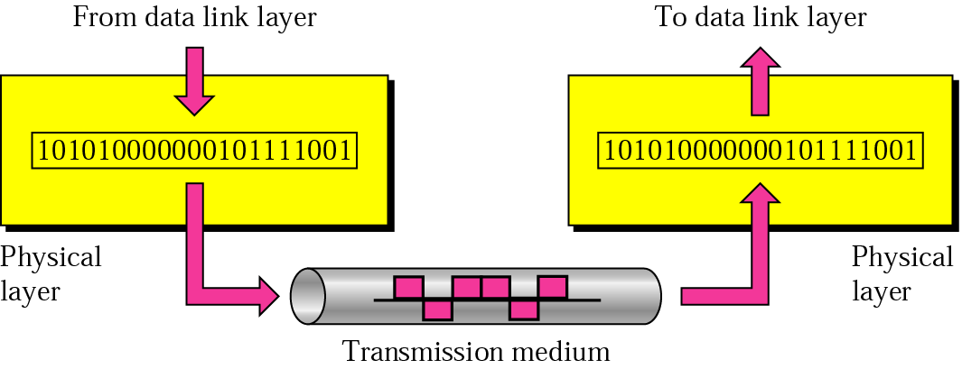
Physical Layer
The physical layer is responsible for transmitting individual bits from one node to the next.

Slide 33
Physical Layer
Responsibilities of Physical Layer :-
Physical Characteristics of interfaces and medium
Representation of bits
Data rate
Synchronization of bits
Line configuration
Physical topology
Transmission mode

Slide 34
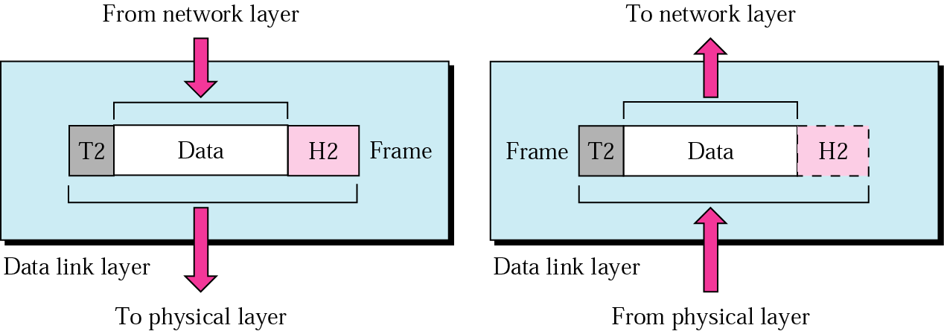
Data Link Layer
The data link layer is responsible for transmitting frames from one node to the next.

Slide 35
Data Link Layer
Responsibilities of Data Link Layer :-
Framing
Physical Addressing
Flow Control
Error Control
Access Control

Slide 36
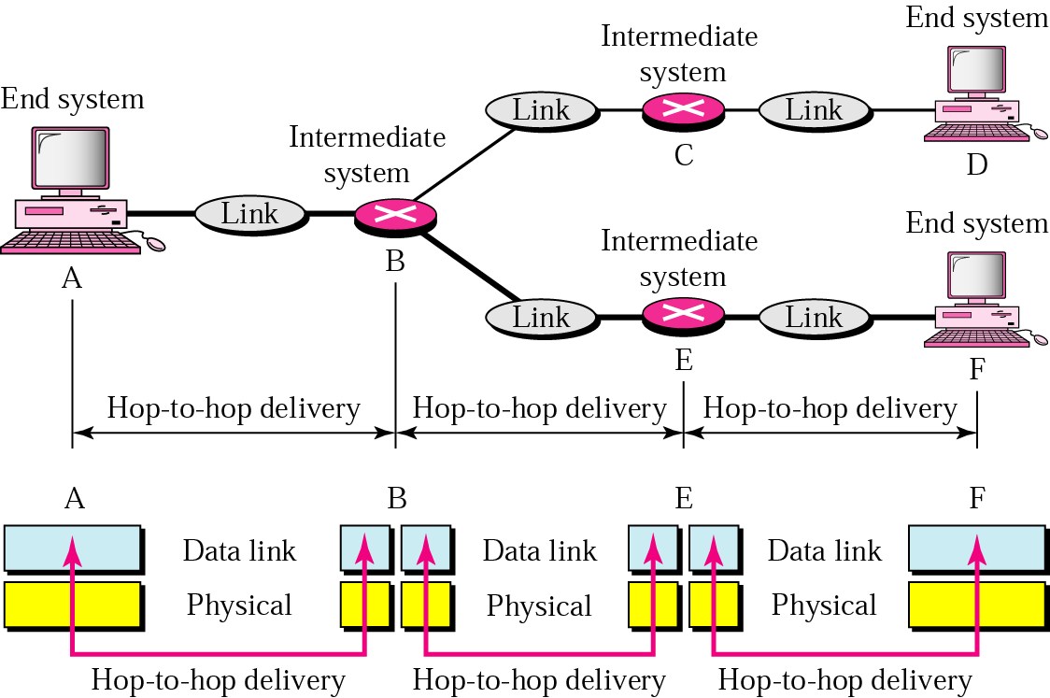
Node to Node Delivery

Slide 37
Node to Node Delivery
Example
In Figure, a node with physical address 10 sends a frame to a node with physical address 87.
The two nodes are connected by a link. At the data link level this frame contains physical addresses in the header. These are the only addresses needed.
The rest of the header contains other information needed at this level. The trailer usually contains extra bits needed for error detection

Slide 38
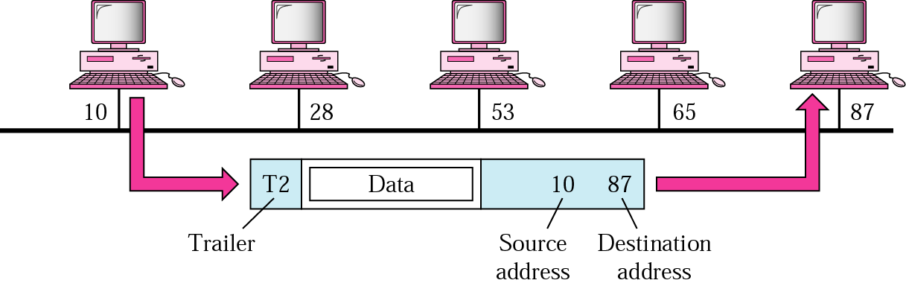
Node to Node Delivery
Example

Slide 39
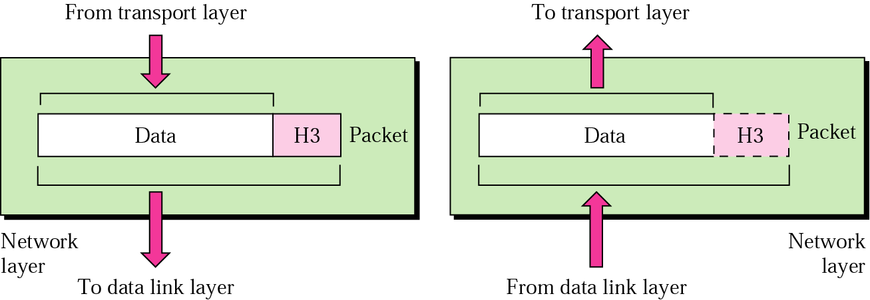
Network Layer
The network layer is responsible for the delivery of packets from the original source to the final destination.

Slide 40
Network Layer
Responsibilities of Network Layer :-
Logical Addressing
Routing

Slide 41
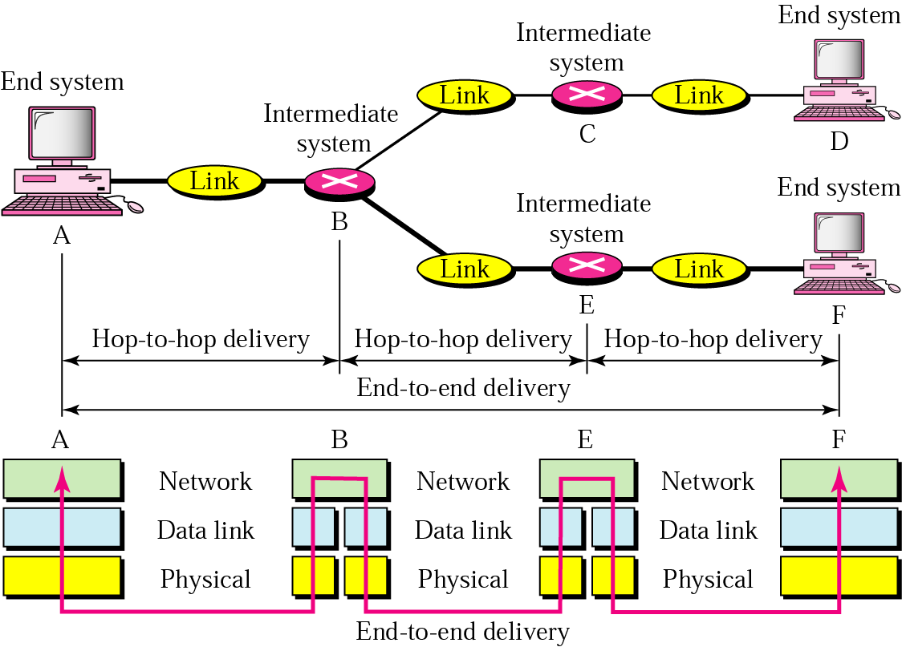
Source – to - Destination
Notes:
Tells the address to and from. Routers are used here for delivery of message

Slide 42
Source – to - Destination
Example
In Figure, we want to send data from a node with network address A and physical address 10, located on one LAN, to a node with a network address P and physical address 95, located on another LAN.
Because the two devices are located on different networks, we cannot use physical addresses only; the physical addresses only have local jurisdiction.
What we need here are universal addresses that can pass through the LAN boundaries. The network (logical) addresses have this characteristic.

Slide 43
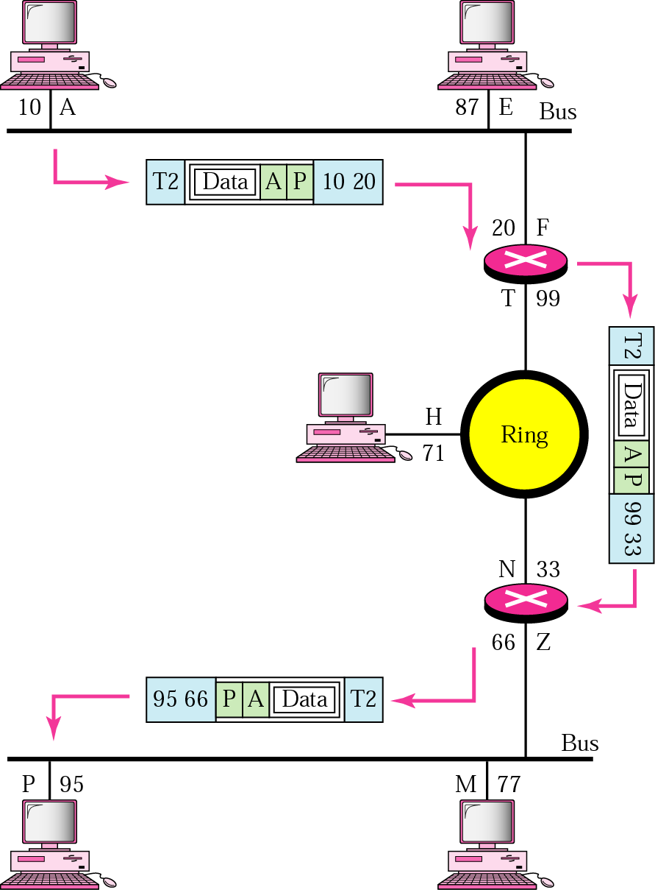
Source – to - Destination
Example

Slide 44
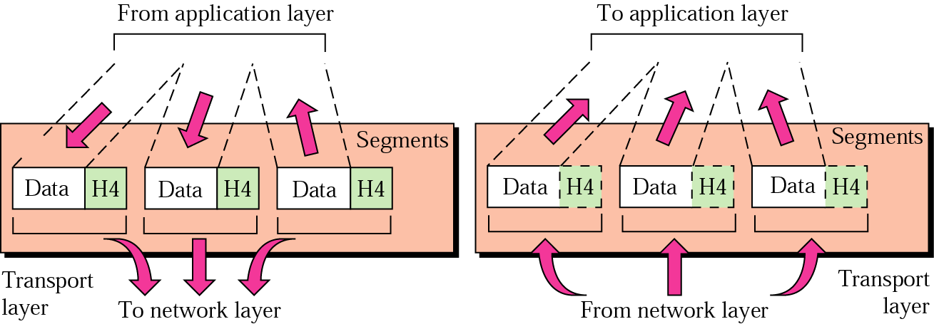
Transport Layer
The transport layer is responsible for delivery of a message from one process to another.
Notes:
Breaks the data into segments

Slide 45
Transport Layer
Responsibilities of Transport Layer :-
Service-point addressing
Segmentation and reassembly
Connection control
Flow control
Error Control

Slide 46
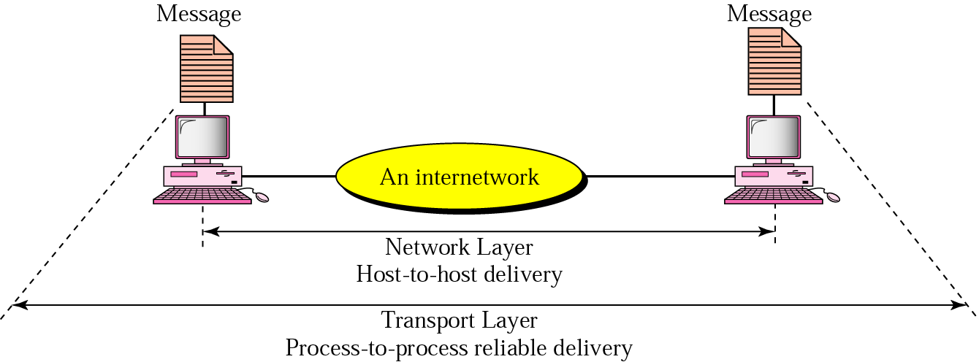
Process to Process

Slide 47
Process to Process
Example
Figure, shows an example of transport layer communication. Data coming from the upper layers have port addresses j and k (j is the address of the sending process, and k is the address of the receiving process).
Since the data size is larger than the network layer can handle, the data are split into two packets, each packet retaining the port addresses (j and k). Then in the network layer, network addresses (A and P) are added to each packet.

Slide 48
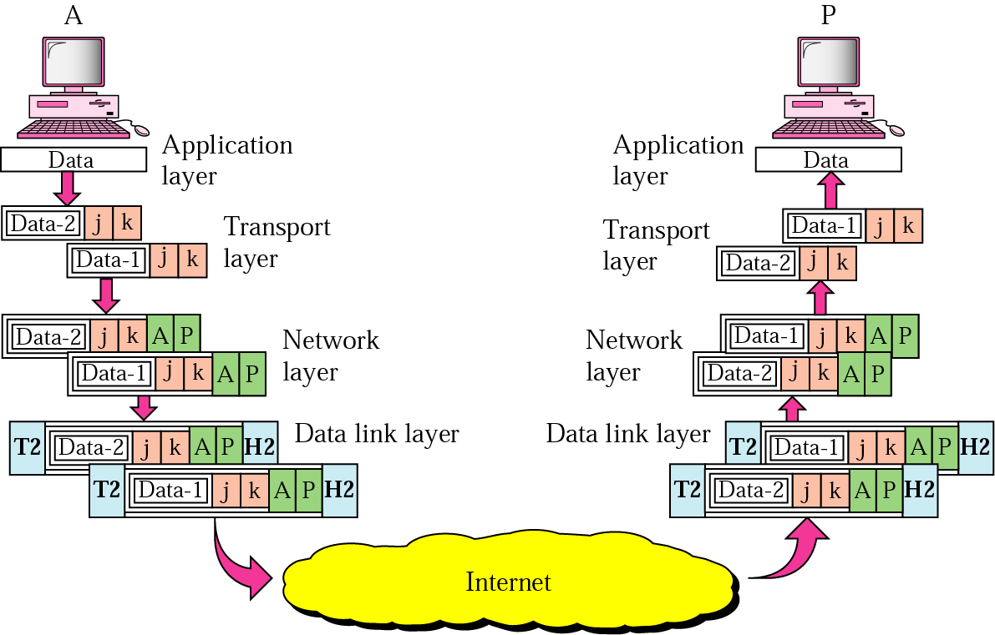
Process to Process
Example

Slide 49
Session Layer
The session layer is responsible for dialog control and synchronization.

Slide 50
Presentation Layer
The presentation layer is responsible for translation, compression, and encryption.

Slide 51
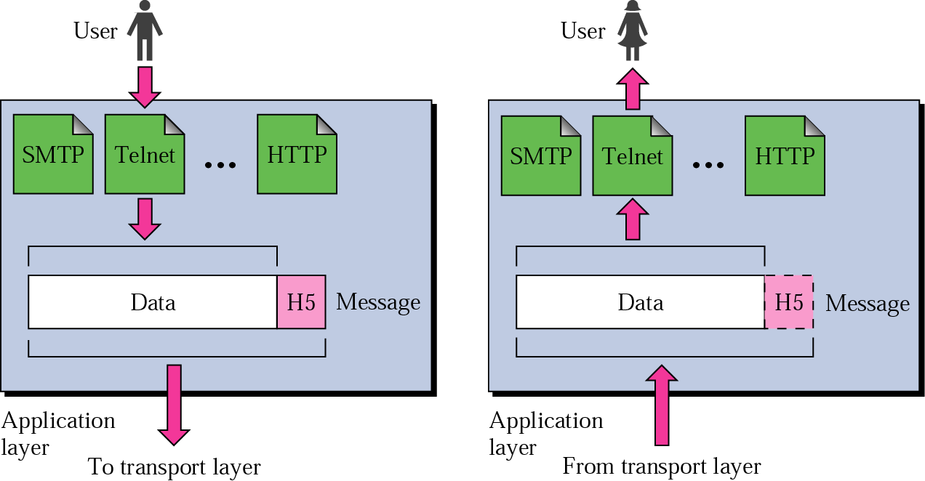
Application Layer
The application layer is responsible for providing services to the user.

Slide 52
Application Layer
Services provided by the Application Layer :-
Network virtual terminal
File transfer, access and management
Mail services
Directory services

Slide 53
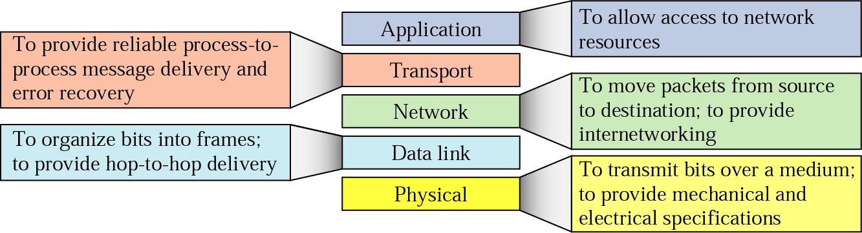
Summary of Layers

Slide 54
OSI Model

Slide 55
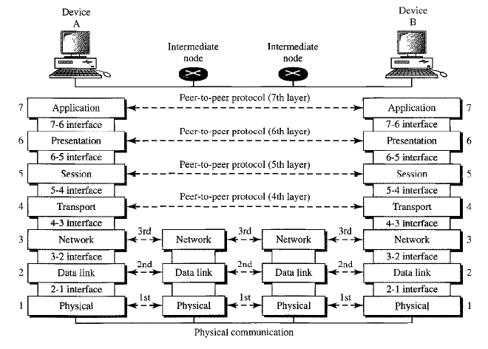
OSI Model

Slide 56
OSI Model
Physical layer | Deals with the mechanical and electrical specification of the interface and transmission media.
Data Link Layer | Transforms the physical layer, to a reliable link and is responsible for node-to-node delivery.
Network Layer | Responsible for the source-to-destination delivery of a packet across multiple links.

Slide 57
OSI Model
Transport Layer | Responsible for the source-to-destination (end-to-end) delivery of the entire message.
Session Layer | It establishes, maintains and synchronizes the interaction between communicating systems.
Presentation Layer | It concerns with the syntax and semantics of the information between two systems.

Slide 58
OSI Model
Application Layer | It provides user interfaces and support for services such as E-Mail, Remote Login and other types of Distributed Information Services.

Slide 59
Reference Models
The OSI Reference Model
The TCP/IP Reference Model
A Comparison of OSI and TCP/IP
A Critique of the OSI Model and Protocols
A Critique of the TCP/IP Reference Model

Slide 60
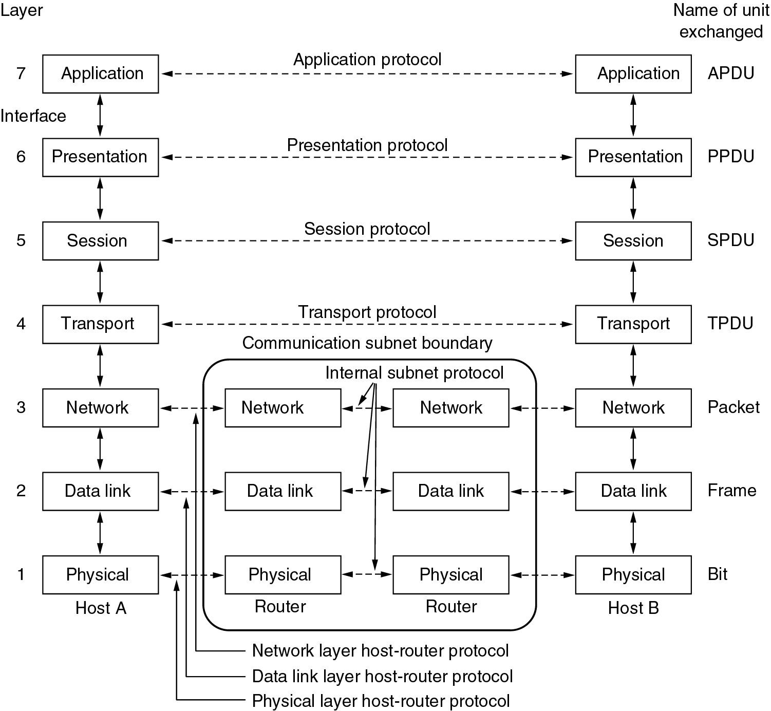
Reference Models
The OSI reference model.

Slide 61
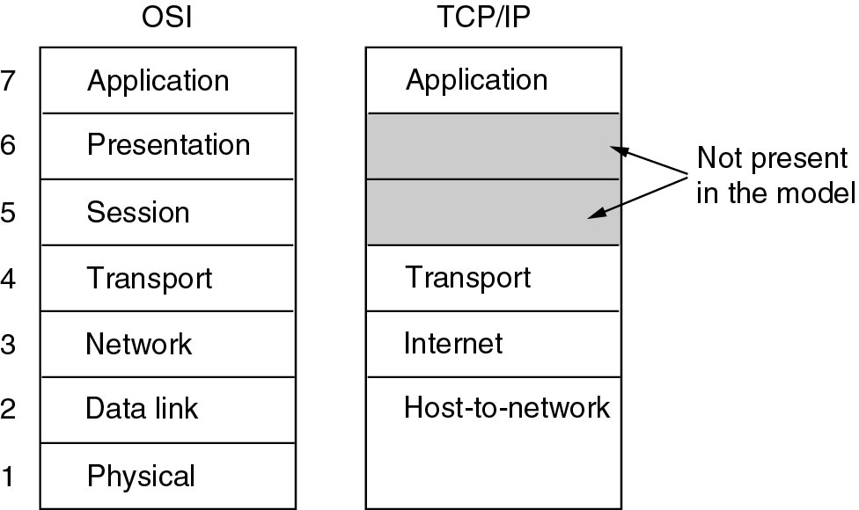
Reference Models (2)
The TCP/IP reference model.

Slide 62
Comparing OSI and TCP/IP Models
Concepts central to the OSI model
Services
Interfaces
Protocols

Slide 63
A Critique of the OSI Model and Protocols
Why OSI did not take over the world
Bad timing
Bad technology
Bad implementations
Bad politics
Disadvantages
Setting up a model is a challenging task.
Sometimes, it becomes difficult to fit a new protocol into this model.
It is only used as a reference model.

Slide 64
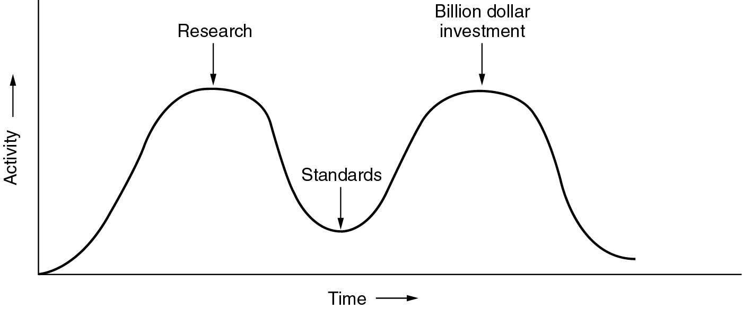
Bad Timing
The apocalypse of the two elephants.

Slide 65
A Critique of the TCP/IP Reference Model
Problems:
Service, interface, and protocol not distinguished
Not a general model
Host-to-network “layer” not really a layer
No mention of physical and data link layers
Minor protocols deeply entrenched, hard to replace

Slide 66
Computer Networks
Physical Layer

Slide 67
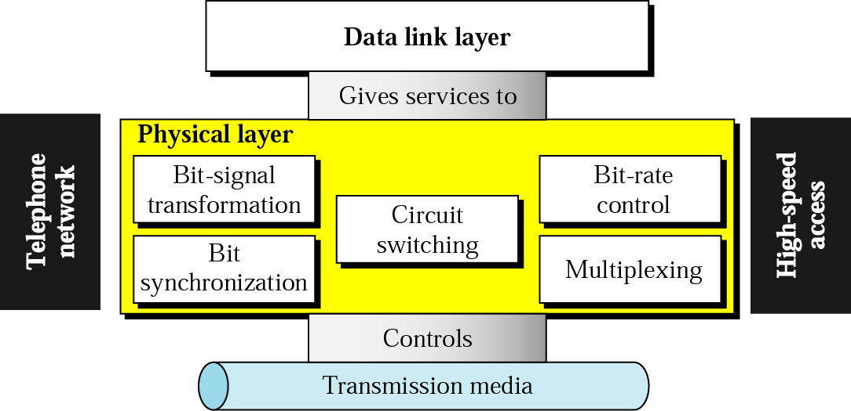
Position of Physical Layer

Slide 68
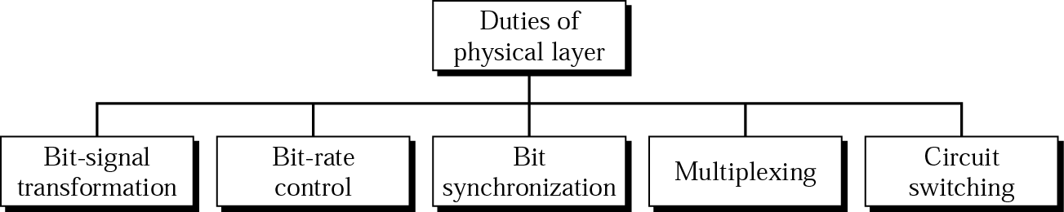
Physical Layer

Slide 69
Physical Layer
Transmission Media

Slide 70
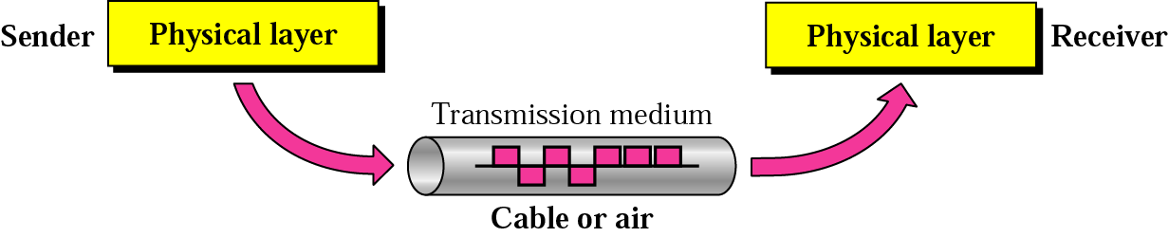
Cont …
Transmission medium and physical layer

Slide 71
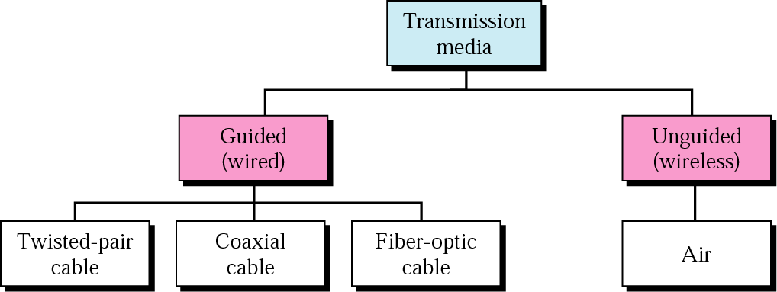
Types of network
Based on communication channel

Slide 72
Cont …
Guided: Transmission capacity depends critically on the medium, the length, and whether the medium is point-to-point or multipoint (e.g. LAN). Examples are co-axial cable, twisted pair, and optical fiber.
Unguided: provides a means for transmitting electro-magnetic signals but do not guide them. Example wireless transmission.

Slide 73
Physical Layer
Guided Media
Twisted-Pair Cable
Coaxial Cable
Fiber-Optic Cable

Slide 74
Physical Layer
A twisted pair consists of two conductors (normally copper), each with its own plastic insulation, twister together
One of the wires is use to carry signals to the receiver, and the other is used only as a ground reference
The receiver uses the difference between the two.
In addition to the signal sent by the sender on one of the wires, interference (noise) and crosstalk may affect both wires and create unwanted signals.
If the two wires are parallel, the effect of these unwanted signals is not the same in both wires because they are at different locations relative to the noise or crosstalk sources.

Slide 75
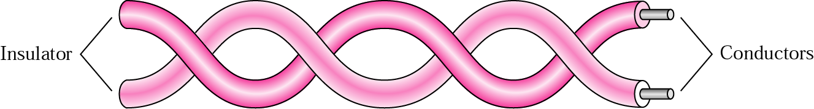
Cont'd…
Twisted-pair cable

Slide 76
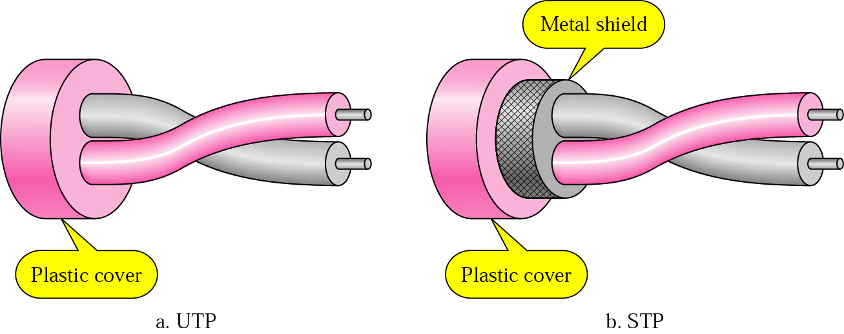
Cont'd…
UTP and STP
UTP: Unshielded twisted pair cable
STP: shielded twisted pair cable, cable has a metal foil covering that encases each pair of insulated conductors. Electro magnetic noise penetration is prevented by metal casing. Expensive, allow high transmission rate

Slide 77
Cont'd…
Categories of unshielded twisted-pair cables
Category | Bandwidth | Data Rate | Digital/Analog | Use
1 | very low | < 100 kbps | Analog | Telephone
2 | < 2 MHz | 2 Mbps | Analog/digital | T-1 lines
3 | 16 MHz | 10 Mbps | Digital | LANs
4 | 20 MHz | 20 Mbps | Digital | LANs
5 | 100 MHz | 100 Mbps | Digital | LANs
6 (draft) | 200 MHz | 200 Mbps | Digital | LANs
7 (draft) | 600 MHz | 600 Mbps | Digital | LANs

Slide 78
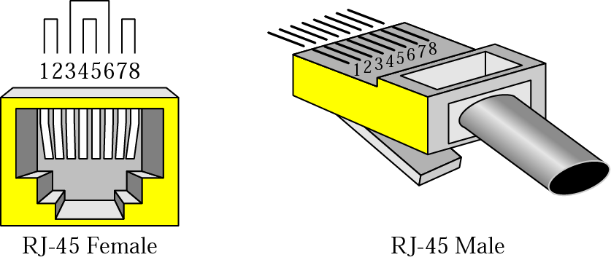
Cont'd…
UTP connector
RJ 45 connector is used with Ethernet cable in computer networking
RJ 11 connector is used in connecting telephone units

Slide 79
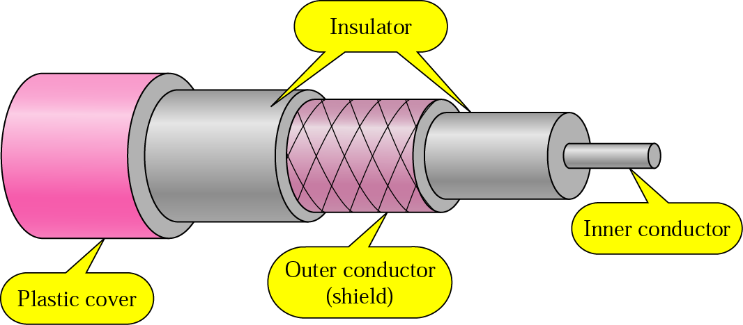
Cont'd…
Coaxial cable
Notes:
Eg: used in set top box for cables at home

Slide 80
Cont'd…
Coaxial cable carries signals of higher frequency ranges than those in twisted pair cable, in part because the two media are constructed differently.
Instead of having two wires, coax has a central core conductor of solid or stranded wire (usually copper), enclosed in an insulating sheath , which is, in turn encased in an outer conductor of metal foil.
The outer metallic wrapping serves both as a shield against noise and as the second conductor, which completes the circuit.
This outer conductor is also enclosed in an insulating sheath, and the whole cable is protected by a plastic cover.

Slide 81
Cont'd…
Categories of coaxial cables
Category | Impedance | Use
RG-59 | 75 Ω | Cable TV
RG-58 | 50 Ω | Thin Ethernet
RG-11 | 50 Ω | Thick Ethernet
RG-Radio Government (ratings)
Each RG number denotes a unique set of physical specification
Notes:
Coaxial cables are categorized by RG ratings

Slide 82
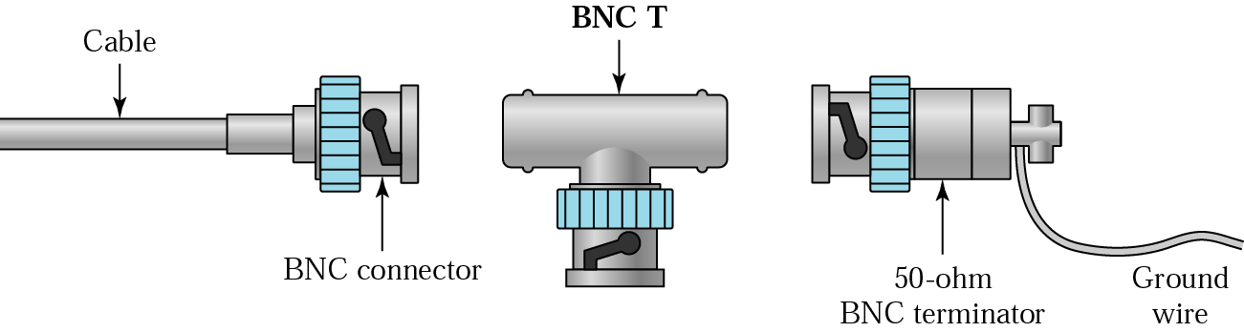
Cont'd…
BNC connectors
BNC – Bayone-Neill-Concelman

Slide 83
Cont'd…
The BNC connector is used to connect the end of the cable to a device, such as a TV set
BNC T connector is used in ETHERNET
BNC terminator is used at the end of the cable to prevent the reflection of the signal.

Slide 84
Cont'd…
The attenuation is much higher in coaxial cable that in twister pair.
In other words, although coaxial cable has a much higher bandwidth, the signal weakens rapidly and requires the frequent use of repeaters.
It is less affected by external magnetic field.

Slide 85
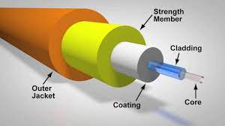
Optical Fiber
Optical Fiber is made of glass or plastic and transmit signals in the form of light.
Light travels in a straight line as long as it is moving through a single medium substance.
If a ray of light traveling through one instance suddenly enters another substance (of a different density), the ray changes direction.

Slide 86
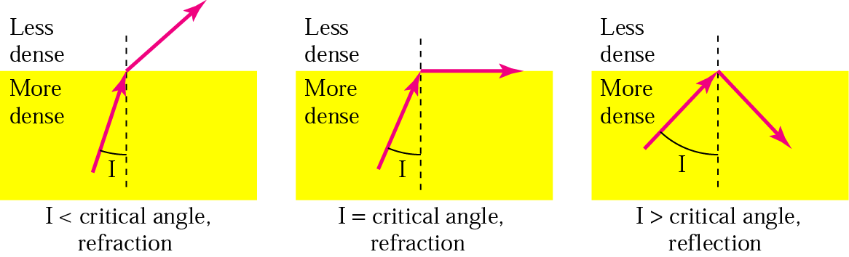
Cont …
Bending of light ray

Slide 87
Optical Fiber
If the angle of incidence I (the angle the ray makes with the line perpendicular to the interface between the two substance) is less that the critical angle, the ray refracts and moves closer to the surface.
If the angle of incidence is equal to the critical angle, the light bends along the surface.
If the angle I greater than the critical angle, the ray reflects (makes a turn) and travels again in the denser substance.
Note that the critical angle is property of the substance, and its value differs from one substance to another.

Slide 88
Optical Fiber
Optical fibers use reflection to guide light through a channel.
A glass or plastic is surrounded by a cladding of less dense glass or plastic.
The difference in density of the two materials must be such that a beam of light moving through the core is reflected of the cladding instead of being refracted into it.

Slide 89
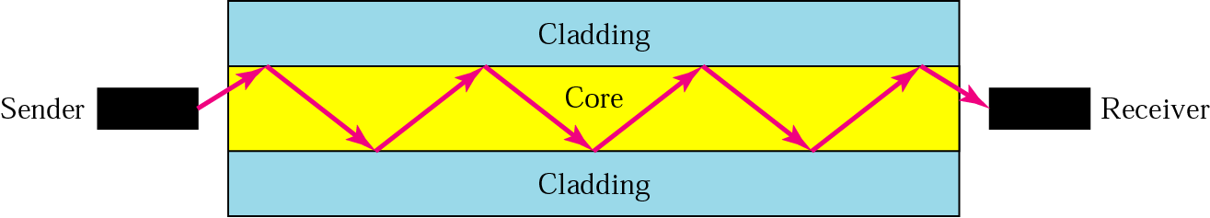
Cont …
Optical fiber

Slide 90
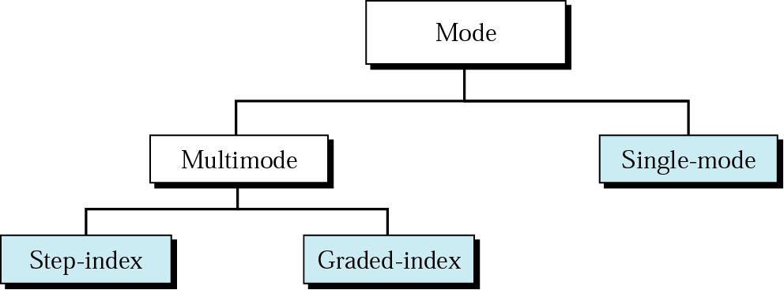
Cont'd…
Propagation modes

Slide 91
Optical Fiber
Multimode is so named because multiple beams from a light source move through the core in different paths.
In multimode step-index fiber, the density of the core remains constant from the center to the edges.
A beam of light moves through this constant density in a straight line until it reaches the interface of the core and the cladding.
At the interface, there is an abrupt change due to a lower density, this alters the angle of the beam’s motion.
The term step index refers to the suddenness of this change, which contributes to the distortion of the signal as it passes through the fiber.

Slide 92
Optical Fiber
Multimode step index fibers are similar to the single mode step index fibers except the center core is much larger with multimode configuration.
With this large core diameter there are many paths through which light can travel.
This type of fiber has a large light to fiber aperture and allows more light to enter the fiber.
The light rays that strike the core/cladding interface at an angle greater than the critical angle are propagated down the core in a zigzag fashion.

Slide 93
Optical Fiber
Light rays that strike the core/cladding interface at an angle less than the critical angle enter the cladding and are lost.
Light rays take different paths down the fiber, which results in large difference in propagation times.
Due to this light rays travelling down fiber have a tendency to spread out.

Slide 94
Optical Fiber
Multimode graded-index fiber, decreases this distortion of the signal through the cable.
The word index here refers to the index of refraction.
Refraction is related to the density.
A graded-index fiber, therefore is one with varying densities.
Density is highest at the center of the core and decreases gradually to its lowest at the edge.

Slide 95
Optical Fiber
The multimode graded index fiber is an improvement on the multimode step index fiber.
Multimode graded index fibers have non-uniform refractive index.
This fiber has maximum density at the center which gradually decreases towards the outer edge.
Light rays propagate down this type of fiber through refraction rather than reflection.

Slide 96
Optical Fiber
As the light rays propagate down the fiber, the rays travelling in the outer most area of the fiber travel a greater distance than the rays travelling near the center.
Because the refractive index decreases with distance from the center, the light rays travelling farthest from the center propagate at a higher velocity.
Therefore all light rays take approximately the same time to travel the length of the fiber.

Slide 97
Optical Fiber
Single-mode uses step-index fiber and a highly focused source of light that limits beams to a small range of angles, all close to horizontal.
The single mode fiber itself is manufactures with a much smaller diameter than that of multimode fiber, and with substantially lower density (index of refraction).

Slide 98

Cont'd…
Modes

Slide 99
Cont'd…
Fiber types
Type | Core | Cladding | Mode
50/125 | 50 | 125 | Multimode, graded-index
62.5/125 | 62.5 | 125 | Multimode, graded-index
100/125 | 100 | 125 | Multimode, graded-index
7/125 | 7 | 125 | Single-mode

Slide 100

Cont'd…
Fiber construction

Slide 101
Optical Fiber
The outer jacket is made of either PVC or Teflon.
Inside the jacket are KEVLAR strands to strengthen the cable.
KEVLAR is a strong material used in the fabrication of bulletproof vests.
Below the KEVLAR is another plastic coating to cushion the fiber.
The fiber is at the center of the cable, and it consists of cladding and core.

Slide 102

Cont …
Fiber-optic cable connectors

Slide 103
Optical Fiber
Subscriber Channel (SC) connector is used for cable TV. It used push/pull locking system.
Straight Tip (ST) connector is used for connecting cable to networking devices.
It uses a bayonet locking system and is more reliable than SC.
MT-RJ is a connector that is the same size as RJ45.

Slide 104

Cont'd…
Optical fiber performance

Slide 105
Cont'd…
Unguided Media: Wireless
Unguided transmission is used when running a physical cable (either fiber or copper) between two end points is not possible.
For example, running wires between buildings is probably not legal if the building is separated by a public street.
Infrared signals typically used for short distances (across the street or within same room),
Microwave signals commonly used for longer distances (10's of km). Sender and receiver use some sort of dish antenna

Slide 106
Cont'd…
Unguided Media: Wireless
Difficulties:
Weather interferes with signals. For instance, clouds, rain, lightning, etc. may adversely affect communication.
2. Radio transmissions easy to tap. A big concern for companies worried about competitors stealing plans.
3. Signals bouncing off of structures may lead to out-of-phase signals that the receiver must filter out.

Slide 107


Cont …
Electromagnetic spectrum for wireless communication
Notes:
Wireless medium uses electro magnetic waves to transmit. Wavelength is between crust and trough. Higher wavelength less frequency. Higher frequency less wavelength. Higher frequency, higher energy, so as frequency increases it is harmful with more energy.

Slide 108

Cont'd…
Propagation methods

Slide 109
WIRELESS
Ground propagation – radio waves travel through the lowest portion of the atmosphere.
These low-frequency signals emanate in all directions form the transmitting antenna and follow the curvature of the planet.
Distance depends on the amount of power of the signal : The greater the power, the greater the distance.

Slide 110
WIRELESS
Sky propagation- higher-frequency radio waves radiate upward into the ionosphere (the layer of atmosphere where particles exists as ions) where they are reflected back to the earth.
This type of transmission allows for greater distances with lower output power.

Slide 111
WIRELESS
Line –of-Sight propagation - very high-frequency signals are transmitted in straight lines directly from antenna to antenna.
Antennas must be directions, facing each other, and either tall enough or close enough together not to be affected by the curvature of the earth.

Slide 112
Cont …
Bands
Band | Range | Propagation | Application
VLF | 3–30 KHz | Ground | Long-range radio navigation
LF | 30–300 KHz | Ground | Radio beacons and navigational locators
MF | 300 KHz–3 MHz | Sky | AM radio
HF | 3–30 MHz | Sky | Citizens band (CB), ship/aircraft communication
VHF | 30–300 MHz | Sky and line-of-sight | VHF TV, FM radio
UHF | 300 MHz–3 GHz | Line-of-sight | UHF TV, cellular phones, paging, satellite
SHF | 3–30 GHz | Line-of-sight | Satellite communication
EHF | 30–300 GHz | Line-of-sight | Long-range radio navigation

Slide 113

Wireless transmission waves

Slide 114
RADIO WAVE
Ranges in frequencies between 3 Khz and 1 Ghz.
Radio waves use omnidirectional antenna.
When an antenna transmits radio waves, they are propagated in all directions.
This means that the sending and receiving antenna do not have to be aligned.
A sending antenna send waves that can be received by any receiving antenna.
It has a disadvantage , that radio waves transmitted by one antennas are susceptible to interference by another antenna that may send signals using the same frequency or band.

Slide 115

RADIO WAVE
Omnidirectional antenna of radio waves make them useful for multicasting, in which there is one sender but many receivers
Notes:
Omnidirection: in all directions

Slide 116
Cont …
Note:
Radio waves are used for multicast communications, such as radio and television, and paging systems. AM, FM, Television, Cordless Phone and paging

Slide 117
Microwave
Electromagnetic waves having frequencies between 300 Mhz and 300 GHz are called micro-waves.
It uses uni-directional antenna
When an antenna transmits microwave waves, they can be narrowly focused.
This means that the sending and receiving antennas need to be aligned.
It has an advantage, a pair of antennas can be aligned without interfering with another pair of aligned antennas.

Slide 118
Microwave
Unidirectional antenna can be parabolic dish antenna and the horn
A parabolic antenna is based on the geometry of a parabola : Every line parallel to the line of symmetry reflects off the curve at angles such that all the lines intersect in a common point called the focus.
The parabolic dish works as a funnel, catching a wide range of waves and directing them to a common point.
In this way, more of the signal is recovered than would be possible with a single-point receiver.

Slide 119
Microwave
Outgoing transmission are broadcast through a horn aimed at the dish.
The microwaves hit the dish and are deflected outward in a reversal of the receipt path
Outgoing transmission are broadcast up a stem (resembling a handle) and deflected outward in a series of narrow parallel beams of a curved head.
Received transmissions are collected by the scooped shape of the horn, in a manner similar to the parabolic dish, and deflected down into the stem.
USED IN CELLULAR PHONES, SATELLITE NETWORKS, WIRELESS LANs

Slide 120

Cont …
Unidirectional antennas

Slide 121
Cont …
Note:
Microwaves are used for unicast communication such as cellular telephones, satellite networks, and wireless LANs.

Slide 122
Cont …
Note:
Infrared signals can be used for short-range communication in a closed area using line-of-sight propagation.

Slide 123
Satellite Networks
Microwave frequencies, which travel in straight lines, are commonly used for wideband communication.
The curvature of the earth results in obstruction of the signal between two earth stations and the signal also gets attenuated with the distance it traverses.
To overcome both the problems, it is necessary to use a repeater, which can receive a signal from one earth station, amplify it, and retransmit it to another earth station.
Larger the height of a repeater from the surface of the earth, longer is the distance of line-of-sight communication.
Notes:
123

Slide 124
Satellite Networks
Satellite networks were originally developed to provide long-distance telephone service.
So, for communication over long distances, satellites are a natural choice for use as repeaters in the sky.
Notes:
124

Slide 125

Satellite Networks

Slide 126

Satellite Networks

Slide 127
Satellite Networks
Three different types categories(basis: location of the orbit)
These orbits are chosen such that the satellites are not destroyed by the high-energy charged particles present in the two Van Allen belts,
The Low Earth Orbit (LEO) is below the lower Van Allen belt in the altitude of 500 to 2000 Km. T
he Medium Earth Orbit (MEO) is in between the lower Van Allen belt and upper Van Allen belt in the altitude of 5000 to 15000 Km.
Above the upper Van Allen belt is the Geostationary Earth Orbit (GEO) at the altitude of about 36,000 Km.
Below the Geostationary Earth Orbit and above the upper Van Allen belt is Global Positioning System (GPS) satellites at the altitude of 20,000 Km.
Notes:
127

Slide 128

Satellite Networks
Notes:
128

Slide 129

Satellite Networks

Slide 130
Satellite Networks
Frequency Bands
Two frequencies are necessary for communication between a ground station and a satellite; one for communication from the ground station on the earth to the satellite called uplink frequency and another frequency for communication from the satellite to a station on the earth, called downlink frequency.
These frequencies, reserved for satellite communication, are divided in several bands such as L, S, Ku, etc are in the gigahertz (microwave) frequency range as shown in Table . Higher the frequency, higher is the available bandwidth.
Notes:
130

Slide 131
Satellite Networks
Satellite frequency band
Band | Downlink, GHz | Uplink, GHz | Bandwidth, MHz
L | 1.5 | 1.6 | 15
S | 1.9 | 2.2 | 70
C | 4 | 6 | 500
Ku | 11 | 14 | 500
Ka | 20 | 30 | 3500

Slide 132

Satellite Networks
LEO satellite system

Slide 133

Satellite Networks
Iridium constellation
The Iridium system has 66 satellites in six LEO orbits, each at an altitude of 750 km.

Slide 134

Satellite Networks
Medium Earth Orbit
GPS
Notes:
134

Slide 135
Satellite Networks
GPS
The Global Positioning System (GPS) is a satellite-based navigation system. It comprises a network of 24 satellites at an altitude of 20,000 Km (Period 12 Hrs) and an inclination of 55° as shown in Fig.
Originally intended for military applications and deployed by the Department of Defence, the system is available for civilian use since 1980.
Allows land, sea and airborne users to measure their position, velocity and time.
Works in any weather conditions, 24 hrs a day.
Positioning is accurate to within 15 meters.
Notes:
135

Slide 136
Physical Layer
Signals

Slide 137
Physical Layer
To be transmitted, data must be transformed to electromagnetic signals.

Slide 138
Physical Layer
Signals can be analog or digital. Analog signals can have an infinite number of values in a range; digital signals can have only a limited number of values.

Slide 139

Physical Layer
Comparison of analog and digital signals

Slide 140
Analog Signals
Sine Wave
Phase
Examples of Sine Waves
Time and Frequency Domains
Composite Signals
Bandwidth

Slide 141

Sine Wave

Slide 142

Amplitude

Slide 143
Signals
Frequency is the rate of change with respect to time. Change in a short span of time means high frequency. Change over a long span of time means low frequency.

Slide 144
Signals
If a signal does not change at all, its frequency is zero. If a signal changes instantaneously, its frequency is infinite.

Slide 145

Signals

Slide 146
Signals
The bandwidth is a property of a medium: It is the difference between the highest and the lowest frequencies that the medium can satisfactorily pass.

Slide 147
Signals
Here, we use the term bandwidth to refer to the property of a medium or the width of a single spectrum.

Slide 148

Bandwidth

Slide 149

Example

Slide 150

Digital Versus Analog

Slide 151
Transmission Impairment
A transmission impairment is a property of a transmission medium which causes the signal to be degraded, reduced in amplitude, distorted or contaminated.
Impairment can introduce errors into digital signals.
Examples of transmission impairments are attenuation, delay distortion, and several sources of noise including, thermal noise, impulse noise, and inter-modulation noise.

Slide 152

Transmission Impairment

Slide 153
Transmission Impairment
It is important to understand transmission impairments for several reasons.
Understanding the source of a transmission impairment like attenuation or dispersion will enable the user to partially correct for (equalize the signal) these effects.
Understanding the source of transmission impairments (dispersion, attenuation, impulse noise, thermal noise) can also help the user understand some of the constraints placed on the transmission of data as a result of these effects.

Slide 154
Transmission Impairment
Such constraints include the maximum length of network links, the choice of physical transmission media, the choice of encoding methods, and the data rate supported by the medium.

Slide 155
Transmission Impairment
Attenuation is a property of the transmission medium.
It measures how much energy is absorbed and/or radiated from the traveling signal due to it’s interaction with the transmission medium.
Attenuation is measured as a function of the distance traveled through the transmission medium.

Slide 156
Transmission Impairment
The transmission medium absorbs energy because the signal is influenced by small impurities within it.
Such impurities have different sizes and distributions depending on the type of medium. Impurities of different sizes effect different frequencies in the signal.
The effect of attenuation is, therefore, a function of frequency.

Slide 157
Transmission Impairment
The frequency variation of attenuation can be partially corrected, or equalized, by applying corrections based on a physical model.
When a signal is attenuated it’s amplitude is reduced.
The interpretation of a received signal depends on being able to tell the difference between different signal levels.
If the amplitude is reduced too much by attenuation it becomes impossible to accurately tell the difference between the different signal levels, and the information in the signal is lost.

Slide 158
Transmission Impairment
To prevent this from happening repeaters (digital) or amplifiers (analog) are used.
These devices increase the amplitude of the signal by decoding and retransmitting the signal or increasing the received amplitudes respectively.
By inserting amplifiers or repeaters in the transmission media, the maximum signal propagation distance (a property of the attenuation of the medium) is increased.

Slide 159

Attenuation

Slide 160
Example
Imagine a signal travels through a transmission medium and its power is reduced to half. This means that P2 = 1/2 P1. In this case, the attenuation (loss of power) can be calculated as
Solution
10 log₁₀ (P2/P1) = 10 log₁₀ (0.5P1/P1) = 10 log₁₀ (0.5) = 10(–0.3) = –3 dB

Slide 161

Distortion

Slide 162
Distortion
Dispersion is also a property of the transmission medium.
Signals with different frequencies will travel through a transmission medium with slightly different velocities.
Therefore, the signal will be smeared or distorted when it reaches the destination.
The longer the transmission medium the larger the time difference in the arrival times of the parts of the signal with different frequencies and the more severe the smearing or distortion of the signal.

Slide 163
Distortion
Like attenuation, the physical properties of dispersion can be modeled.
Thus it is also possible to develop an equalization model to partially compensate for dispersion.

Slide 164

Noise

Slide 165
Noise
Noise of different types will affect a transmitting signal.
Thermal noise, low amplitude random noise at predictable low amplitude (amplitude related to the temperature of the transmission medium), is caused by the thermal vibration of the molecules within the transmission medium.
The difference between signal levels in a transmitted signal will generally be much larger than the amplitude of the thermal noise.

Slide 166
Noise
Thermal noise sets a limit of how close different signal levels can be at the receiver (larger than the 2X amplitude of the thermal noise).
Thermal noise will not usually be of high enough amplitude to cause the introduction of bit errors in an encoded signal (unless attenuation has been excessive).
However, impulse noise picked up from the environment can have high amplitude for significant lengths of time

Slide 167
Noise
Such impulse noise can be caused by interference from other signals in the environment including other transmitted signals, or electrical fields natural (lightning, aurora) or manmade (signals emitted by other electrical equipment).
The amplitude of impulse noise may reach or exceed the magnitude of the signal.

Slide 168
Noise
The duration of a pulse of impulse noise may be several time the duration of a single signal.
Because of the large amplitude of the impulse noise pulse it is possible that, when added to the real signal, the resultant received signal may appear to have been transmitted at a different level that it actually was.

Slide 169
Noise
For example,
for a signal with three levels (1 , 0, -1) and impulse noise has an amplitude of 1 added to a signal, the resulting received signal will have a level of (0, 1, 2).
During the noise pulse a signal transmitted at level 0 will arrive at the receiver with an amplitude of 1,.
Similarly a signal transmitted at level -1 will arrive at the receiver with an amplitude of 0. In both cases the level of the received signal will be different from the signal that was sent.
When the signal is decoded the resulting value of the data bit will have changed in transmission. A bit error has been introduced into the received signal.

Slide 170
Signals
Throughput
Propagation Speed
Propagation Time
Wavelength

Slide 171

Throughput

Slide 172

Propagation Time

Slide 173

Wave Length

Slide 174
Signals
Digital Transmission

Slide 175
Characterstics
Some Characteristics
Line Coding Schemes
Some Other Schemes

Slide 176
Characterstics
The basis of analog signaling is a constant frequency signal known as a carrier signal, which is chosen to be compatible with the transmission media being used, so that it can traverse a long distance with minimum of attenuation and distortion.
Data can be transmitted using these carrier signals by a process called modulation, where one or more fundamental parameters of the carrier wave, i.e. amplitude, frequency and phase are being modulated by the source data.
The resulting signal, called modulated signal traverses the media, which is demodulated at the receiving end and the original signal is extracted.

Slide 177
Characterstics
No of signal levels: This refers to the number values allowed in a signal, known as signal levels, to represent data.
Bit rate versus Baud rate:
The bit rate represents the number of bits sent per second, whereas the baud rate defines the number of signal elements per second in the signal.
Depending on the encoding technique used, baud rate may be more than or less than the data rate.

Slide 178

Line Coding

Slide 179

Signal Levels Vs Data level

Slide 180

Digital Signal Encoding Formats

Slide 181
Unipolar Encoding
In unipolar encoding technique, only one voltage levels are used.
It uses only one polarity of voltage level
Unfortunately, DC component present in the encoded signal and there is loss of synchronization for long sequences of 0’s and 1’s.
It is simple but obsolete.

Slide 182

Unipolar Encoding
Unipolar encoding uses only one voltage level.
This scheme is very costly.
Unipolar scheme is normally not used in data communications today.

Slide 183

Polar Encoding
Polar encoding uses two voltage levels (positive and negative).

Slide 184
NRZ Encoding
Non Return to zero (NRZ):
The most common and easiest way to transmit digital signals is to use two different voltage levels for the two binary digits.
Usually a negative voltage is used to represent one binary value and a positive voltage to represent the other.
The data is encoded as the presence or absence of a signal transition at the beginning of the bit time.
As shown in the figure below, in NRZ encoding, the signal level remains same throughout the bit-period.
There are two encoding schemes in NRZ: NRZ-L and NRZ-I, as shown in Fig.

Slide 185

NRZ Encoding

Slide 186
NRZ Encoding
In NRZ-L the level of the signal is dependent upon the state of the bit.
In NRZ-I the signal is inverted if a 1 is encountered.

Slide 187
Digital Transmission
The main problem with NRZ encoding occurs when the sender and receiver clocks are not synchronized. The receiver does not know when one bit has ended and the next bit is starting.
One solution is the RZ (return-to-zero) scheme, which uses three voltage levels.

Slide 188

RZ Encoding

Slide 189
RZ Encoding
Return to Zero RZ: Key characteristics of the RZ coding are:
Three levels
Good synchronization
Main limitation is the increase in bandwidth
The main disadvantage of RZ encoding is that it requires two signal changes to encode a bit and therefore occupies greater bandwidth.

Slide 190
Manchaster
Biphase:
To overcome the limitations of NRZ encoding, biphase encoding techniques can be adopted.
Manchester and differential Manchester Coding are the two common Biphase techniques
In Manchester coding the mid-bit transition serves as a clocking mechanism and also as data.
In the standard Manchester coding there is a transition at the middle of each bit period.
A binary 1 corresponds to a low-to-high transition and a binary 0 to a high-to-low transition in the middle.

Slide 191

Manchester
In Manchester encoding, the transition at the middle of the bit is used for both synchronization and bit representation.

Slide 192

Differential Manchester
In differential Manchester encoding, the transition at the middle of the bit is used only for synchronization. The bit representation is defined by the inversion or noninversion at the beginning of the bit.

Slide 193

Bipolar Encoding
In bipolar encoding, we use three levels: positive, zero, and negative.

Slide 194
Sampling
Pulse Amplitude Modulation
Pulse Code Modulation
Sampling Rate: Nyquist Theorem
How Many Bits per Sample?
Bit Rate

Slide 195
Modulation of Digital Data
Digital-to-Analog Conversion
Amplitude Shift Keying (ASK)
Frequency Shift Keying (FSK)
Phase Shift Keying (PSK)
Quadrature Amplitude Modulation

Slide 196

Digital to Analog

Slide 197

Digital to Analog

Slide 198
Digital to Analog
Bit rate is the number of bits per second. Baud rate is the number of signal units per second. Baud rate is less than or equal to the bit rate.

Slide 199
Digital to Analog
An analog signal carries 4 bits in each signal unit. If 1000 signal units are sent per second, find the baud rate and the bit rate
Solution
Baud rate = 1000 bauds per second (baud/s)
Bit rate = 1000 x 4 = 4000 bps

Slide 200
Digital to Analog
The bit rate of a signal is 3000. If each signal unit carries 6 bits, what is the baud rate?
Solution
Baud rate = 3000 / 6 = 500 baud/s

Slide 201

ASK

Slide 202

FSK

Slide 203

PSK

Slide 204

PSK Constellation

Slide 205

Analog Modulation

Slide 206

Analog Modulation

Slide 207
AM
The total bandwidth required for AM can be determined from the bandwidth of the audio signal: BWt = 2 x BWm.

Slide 208

AM

Slide 209

Frequency Modulation

Slide 210
Sampling
Analog data such as voice, video and music can be converted into digital signal communication through transmission media. This allows the use of modern digital transmission and switching equipment’s. The device used for conversion of analog data to digital signal and vice versa is called a coder (coder-decoder). There are two basic approaches:
Pulse Code Modulation (PCM)
Delta Modulation (DM)

Slide 211
Sampling
Pulse Code Modulation involves the following three basic steps as shown in Fig. :
Sampling – PAM
Quantization
Line coding

Slide 212
Sampling

Slide 213
Sampling
Sampling: This process is based on Shannon’s sampling theorem. Numbers of samples of the signal are taken at regular intervals, at a rate higher than twice the highest significant signal frequency. This basic step is known as Pulse Amplitude Modulation (PAM) as shown in Fig. . For example, during the sampling of voice data, in the frequency range 300 to 4000 Hz, 8000 samples per second are sufficient for the coding

Slide 214
Sampling

Slide 215
PAM
Pulse amplitude modulation has some applications, but it is not used by itself in data communication. However, it is the first step in another very popular conversion method called pulse code modulation.

Slide 216

PAM

Slide 217

PCM

Slide 218

Analog to PCM Digital code

Slide 219
Analog to PCM Digital code

Slide 220
Sampling
According to the Nyquist theorem, the sampling rate must be at least 2 times the highest frequency.

Slide 221
Example
What sampling rate is needed for a signal with a bandwidth of 10,000 Hz (1000 to 11,000 Hz)?
Solution
The sampling rate must be twice the highest frequency in the signal:
Sampling rate = 2 x (11,000) = 22,000 samples/s

Slide 222
Example
We want to digitize the human voice. What is the bit rate, assuming 8 bits per sample?
Solution
The human voice normally contains frequencies from 0 to 4000 Hz.
Sampling rate = 4000 x 2 = 8000 samples/s
Bit rate = sampling rate x number of bits per sample = 8000 x 8 = 64,000 bps = 64 Kbps

Slide 223
Example
We want to digitize the human voice. What is the bit rate, assuming 8 bits per sample?
Solution
The human voice normally contains frequencies from 0 to 4000 Hz.
Sampling rate = 4000 x 2 = 8000 samples/s
Bit rate = sampling rate x number of bits per sample = 8000 x 8 = 64,000 bps = 64 Kbps

Slide 224
Sampling
Delta Modulation (DM)
Delta Modulation is a very popular alternative of PCM with much reduced complexity.
Here the analog input is approximated by a staircase function, which moves up or down by one quantization level (a constant amount) at each sampling interval.
Each sample delta modulation process can be represented by a single binary digit, which makes it more efficient than the PCM technique.

Slide 225
Sampling
In this modulation technique, instead of sending the entire encoding of each and every sample, we just send the change from previous sample.
If the difference between analog input and the feedback signal is positive, then encoded output is 1, otherwise it is 0. So, only one bit is to be sent per sample.

Slide 226

Multiplexing

Slide 227

Dividing a link into channels

Slide 228

Frequency-division multiplexing

Slide 229

Note
FDM is an analog multiplexing technique that combines analog signals.

Slide 230

FDM process

Slide 231

Wavelength-division multiplexing
Notes:
IT’S A PRISM NOT THE MUX HERE

Slide 232

TDM

Slide 233
Cont …
Note
TDM is a digital multiplexing technique for combining several low-rate channels into one high-rate one.

Slide 234

Synchronous Time-Division Multiplexing

Slide 235

Telephone System
Notes:
5 main components: end device, local loop, trunck, local office/tandom office and reginal office

Slide 236

Telephone System

Slide 237

Telephone System

Slide 238
Review Questions (Short)
What is computer networking? Discuss the various types of it.
Give the names of various layers in OSI model. State the role of network layer in it.
What do you mean by wireless transmission? Briefly describe the various media that support wireless transmission.
Distinguish between FSK, PSK and ASK? Discuss Pulse code modulation.

Slide 239
Review Questions (Long)
An analog signal has a bandwidth of 40 KHz. If we sample this signal and send it through a 50Kbps channel. What is the SNR?
Which of the four digital-to-analog conversion techniques (ASK, FSK, PSK or QAM) is the most susceptible to noise? Defend your answer.
Explain Mobile Telephone System.
Difference between guided and unguided media with the help of an example.
Explain Pulse Code Modulation.
What does the Shannon capacity and Nyquist theorem have to do with communication?

Slide 240
Recommended Reading
Behrouz Forouzun, “Data Communication and Networking”:TMH
Tanenbaum , “A computer Networks”: Prentice Hall
Stallings , “High speed Networks” :Prentice Hall
Comer D. “Computer Networks”: Prentice hall
Kurose, J and Ross , “Computer Networking : Addison Wesley

